Slide 1
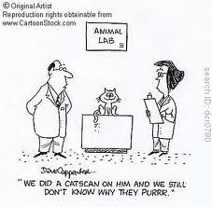
The “Ins and Outs” involving Research, Testing, and Training when using Animals
Sally Olson, DVM, KSU IACUC Chairman

Slide 2
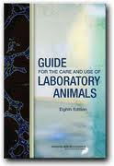
Who and What says we need to be regulated and what “guides” us?
Animal Welfare Act
USDA-APHIS
OLAW

Slide 3
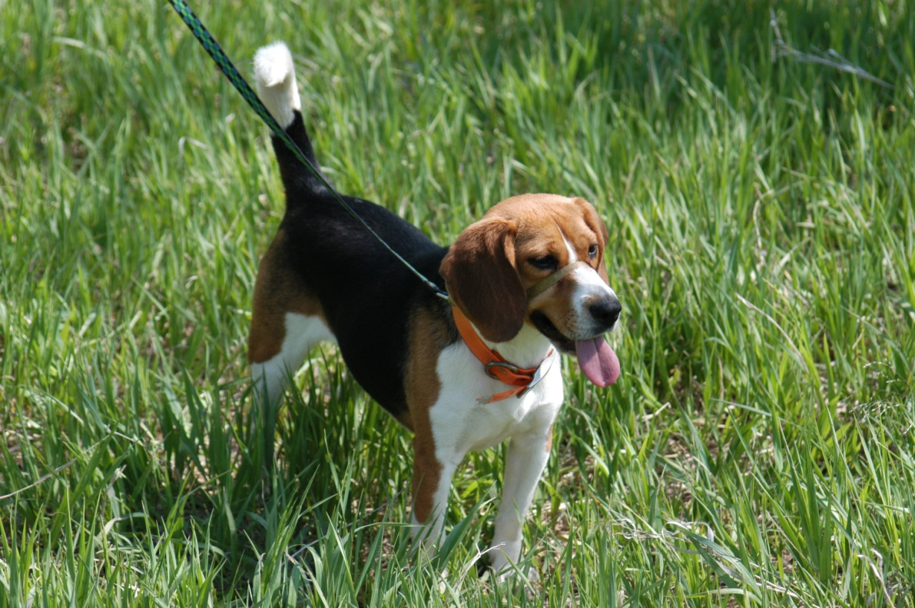
Activity Needing Review
Animal Activity →→→→→ IACUC
Human Subject Activity →→→→→ IRB
Infectious Agents, r-DNA→→→→→ IBC

Slide 4
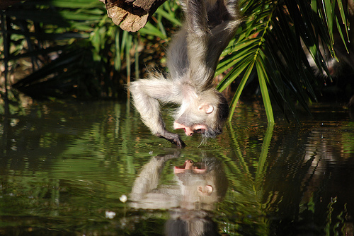
What goes into Using Animals in Research
Literature searches for unnecessary duplication/novel research or hypothesis
Controlled parameters/scope of a project design
Protocol approval
Individuals trained and knowledgeable in the care of the species.
Appropriate housing for the species to include containment of infectious/zoonotic materials/agents
Answering a scientific question while keeping the welfare of the animal at the forefront
Notes:
Realizing one project does not necessarily provide a definitive answer

Slide 5
For the sake of discussions

Slide 6
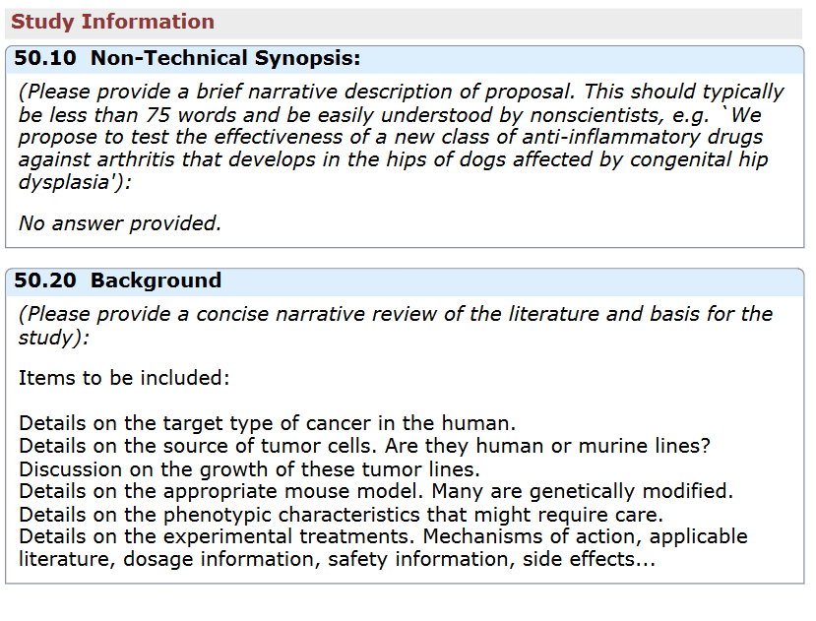
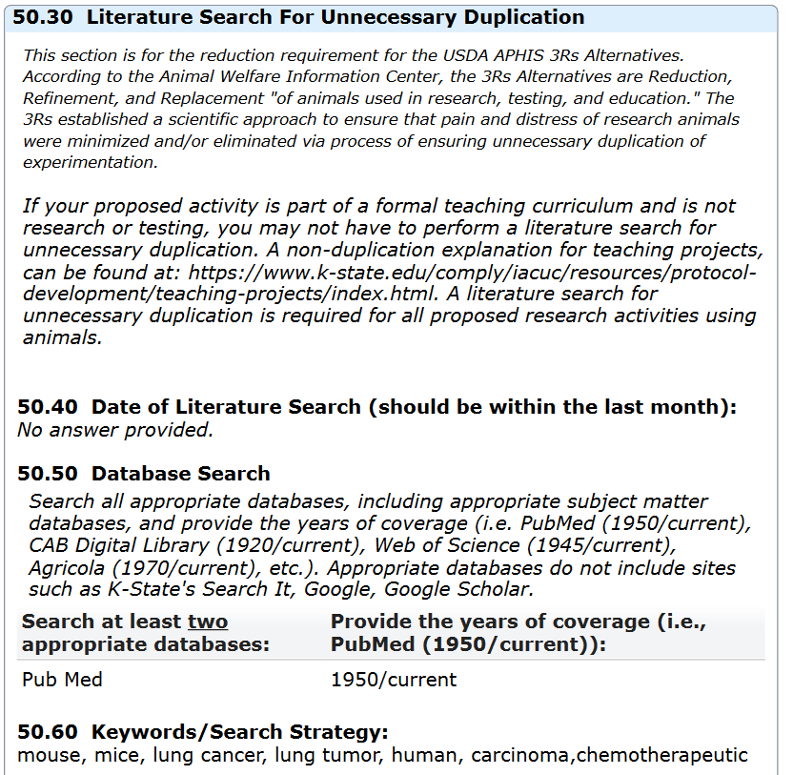
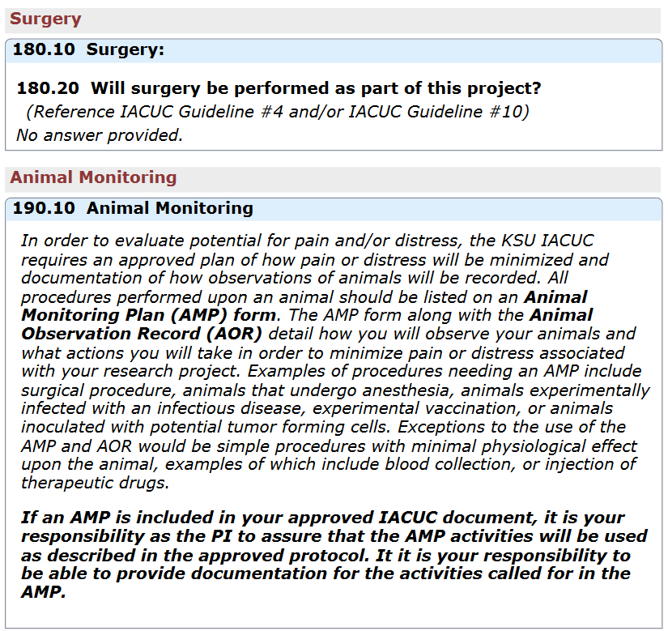
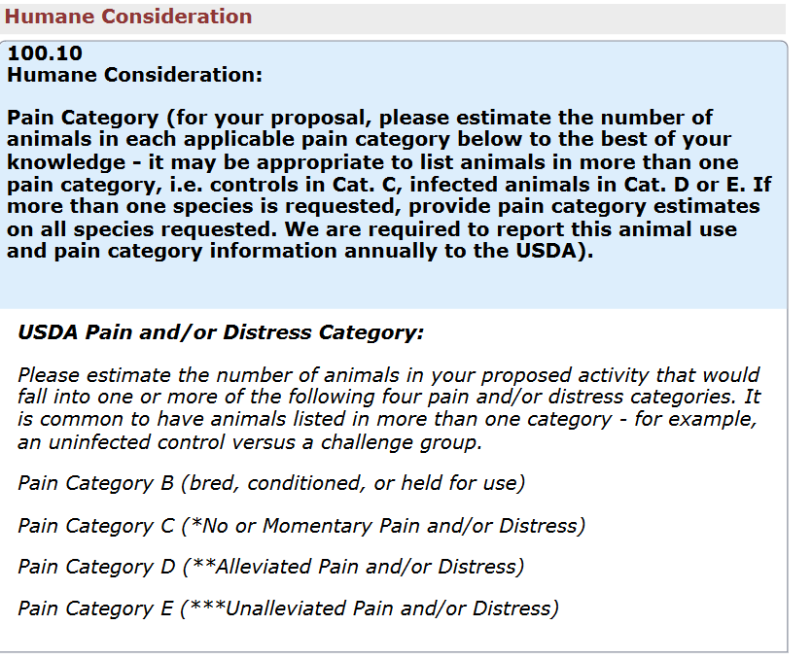
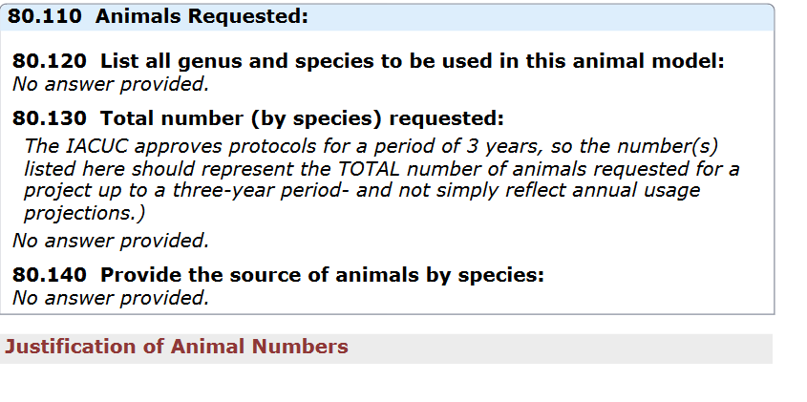
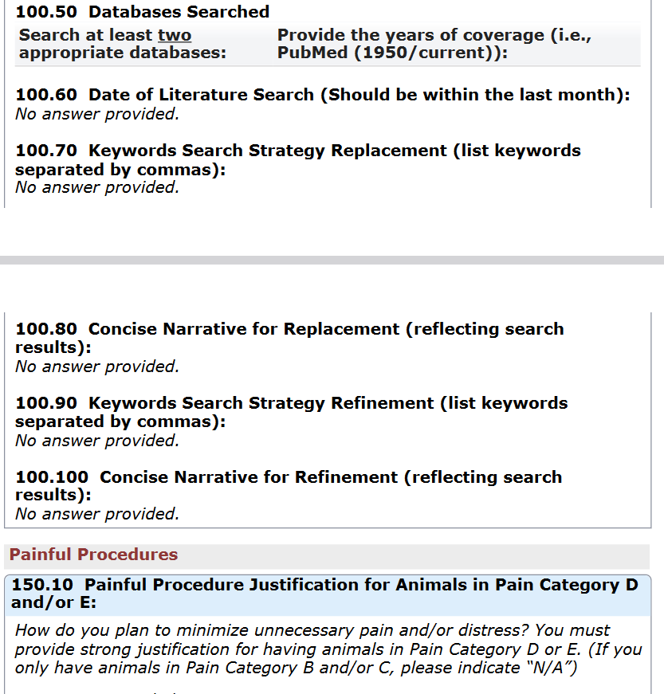
So many ideas….So many questions….where to begin?

Slide 7
Information needed
Background (What supports the line of research and the proposed approach?)
Project Details (How will each animal be used? Living conditions? Exposures? Etc.)
Justifications of species, animal numbers (Correct model? Correct number – not too many and not too few.)
Endpoints (How is the experiment concluded? Alternate endpoints for special situations?)
Disposition (What happens to the animals after the experiment is ended?)
Veterinary care/Oversight (Who, how often, etc.)

Slide 8
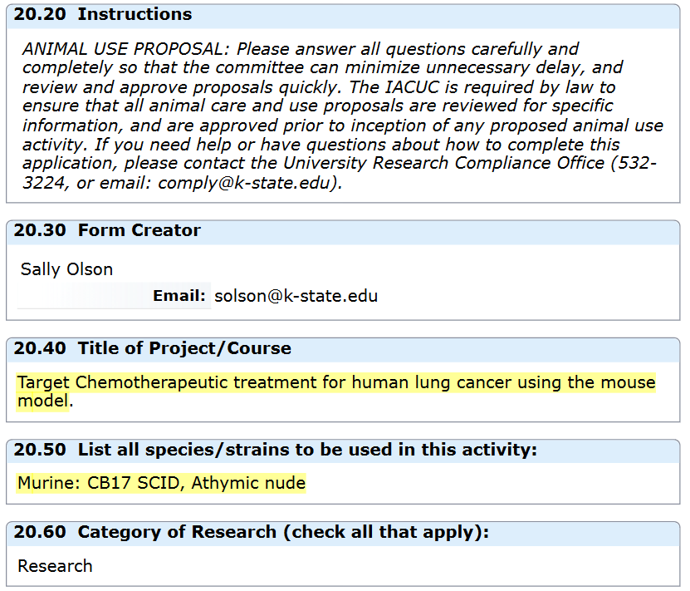

Slide 9
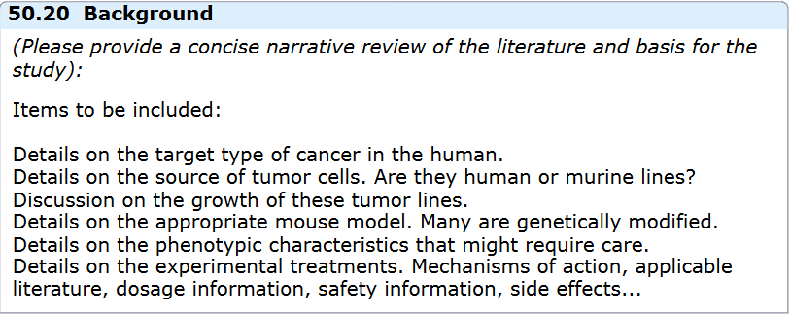
Background (proposal #1)

Slide 10
In addition to justifying the live animal model…why these strains?
CB17 SCID and the Athymic nude mouse
Replacement: Can this question be answered invitro, i.e. cell culture. Or through a computer model?

Slide 11
End Point and Disposition

Slide 12
AVMA Guidelines
for the Euthanasia of Animals:
2020 Edition*
S2.2.2 ACCEPTABLE WITH
CONDITIONS M ETHODS
S2.2.2.1 Inhaled agents
Halogenated anesthetics—Halothane, isoflu-
rane, sevoflurane, or desflurane, with or without
nitrous oxide, is acceptable with conditions for eu-
thanasia of laboratory rodents.50 These agents may
be useful in cases where physical restraint is difficult
or impractical. When used as a sole euthanasia agent
delivered via vaporizer for anesthetic induction and
overdose, animals may need to be exposed for pro-
longed time periods to ensure death.51–57 Death can
be rapid when using the open-drop technique, but
care must be taken to ensure that the rodent does not
come in direct contact with the anesthetic.
Carbon dioxide—Carbon dioxide, with or with-
out premedication with halogenated anesthetics, is
acceptable with conditions for euthanasia of small ro-
dents.58 Compressed CO2 gas in cylinders are the rec-
ommended source of CO2 because gas inflow to the
chamber can be precisely regulated. An optimal flow
rate for CO2 euthanasia systems should displace 30%
to 70% of the chamber or cage volume/min, with the
understanding that there is potential for increased
distress due to dyspnea at lower flow rates or mucous
membrane pain associated with flow rates at the high
ends of this range.31,32,54,56,59–64 However, as there is
no clear evidence of a flow rate that optimally mini-
mizes both pain and distress for all species, sexes, and
genetic backgrounds, veterinarians should use their
professional judgment to determine which flow rate
is appropriate for their circumstances.31,32,56 Prefilled
chambers are not recommended due to the potential
for significant pain upon inhalation of the gas.60,65 If
euthanasia is not conducted in the home cage, induc-
tion chambers should be emptied and cleaned be-
tween uses. Addition of O2 to CO2 will prolong the
time to death and may complicate determination of
consciousness. There appears to be no advantage to
combining O2 with CO2 for euthanasia.11,60
Pgs. 60-61
S2.2 SMALL LABORATORY
AND WILD-CAUGHT RODENTS
(MICE, RATS, HAMSTERS,
GUINEA PIGS, GERBILS,
DEGUS, COTTON RATS, ETC)
All activities related to the euthanasia of rodents
deserve consideration equivalent to the euthanasia
method itself, and may factor into the choice of meth-
od. Activities that contribute to distress in rodents in-
clude transport, handling (in animals not accustomed
to it), disruption of compatible groups, and elimina-
tion of established scent marks.31–45 As eliminating all
sources of distress may not be practical or possible,
the selected method of euthanizing rodents should
minimize these sources of potential distress. Meth-
ods of euthanasia likely to elicit distress vocalizations
or pheromones that other animals in the room could
hear or smell may be best performed in another loca-
tion, if transportation distress can be minimized. Sim-
ilarly, wild-caught animals should be handled and eu-
thanized in the manner least stressful to the animals.
Death should be confirmed by physical examination,
ensured by adjunctive physical method, or obviated
by validation of euthanasia chambers and process.

Slide 13
Veterinary Care/Animal Monitoring

Slide 14
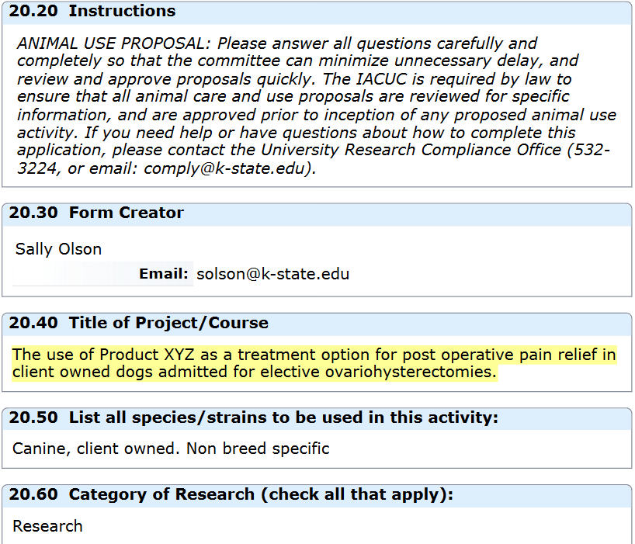
CLIENT OWNED ANIMALS
Client Owned Animals
Elective Surgeries
Pain Relief
FDA Approved Drugs?
Labeled or Extra Labeled

Slide 15
Background Proposal #2

Slide 16
Project Proposal: Materials and Methods

Slide 17
Veterinary Care and Animal Monitoring
One key difference is the fact that these client owned animals are most likely at home. The Animal Monitoring Plan should reflect both observations and parameters to be assessed while in house patients and what the client will be assessing.
Parameters to Monitor and what intervention will occur
What parameters should be assessed?
Should there be a rescue analgesia point?
How to deal with CONFLICT OF INTEREST
Veterinarian Clinicians as the Primary Investigator

Slide 18
End Points and Dispositions

Slide 19
Client Consent
Purpose
Risks
Details of what is happening outside of the routine procedure
Any roles the client plays in the study: i.e. pain assessment at home?
Financial responsibilities
Opting out options

