Slide 1
Ethics & Relationships in the Laboratory
Conflicts of Interest
Authorship

Slide 2
Conflict of Interest at K-State
Conflict of Interest, Conflict of Time Commitment, and Consulting: K-State recognizes the value of faculty and staff interaction with business and industry, private foundations, and government agencies to foster the University mission, facilitate professional development, and promote expansion of knowledge. While these interactions can provide valuable experience, they can also result in an actual or potential conflict of interest or conflict of time commitment. K-State's policy on Conflict of Interest and Conflict of Time Commitment is located in Appendix S of the University Handbook. You should read, and familiarize yourself with this policy.
When a conflict of time or interest is identified, either the conflict should be eliminated or a management plan should be developed and agreed upon by the employee and unit head or immediate supervisor. Supervisors/unit heads are responsible for determining whether a conflict can be adequately managed.
Ownership: Ownership interest in any corporation, partnership, trust, joint venture, and every other business interest, including land used for income which you or other members of your household own or have owned within the preceding 12 months, which represents a legal or equitable interest exceeding $5,000 or five percent, whichever is less. Ownership of intellectual property, e.g., patents, royalties, and copyrights is also included. Ownership of funds and holdings acquired through the Regents' retirement programs is not included.
Are there any ownership interests you have or a member of your family has which meet this criteria? Yes No
Could an independent observer conclude that they appear to influence or potentially conflict with any of your employment duties, such as any research/educational activities, at K-State? Yes No
Notes:
Perception of a conflict (viewed from a colleague of the less powerful person)

Slide 3
Conflict of Interest at K-State
Remuneration: Receipt of salary, compensation, fees, commission, anything of value, or economic benefit conferred within the past 12 months in return for services rendered or to be rendered from one or more outside entities, in excess of $5,000.
Office: A position or office of director, officer, associate, partner, or proprietor in any outside entity in which greater than 5% ownership is held or for which more than $5,000 compensation is received.
Financial Interests Received From any Foreign Entity: Receipt of salary, anything of value, or economic benefit, including sponsored travel, conferred within the past 12 months, or will occur in the next 12 months, received or to be received from any foreign entity, including governments and universities, in return for services rendered or to be rendered. This includes fees received from private consulting or other international business activities, from any one entity or any government.
Conflict of Time Commitment: As discussed on the introductory page, as an employee you must disclose actual and potential conflicts of time.
Have you engaged in any activity (not previously disclosed) or do you expect to engage in any activity in the future that could impact or appear to impact your primary professional responsibility to K-State, your primary commitment of time and intellectual effort to K-State, and/or your presence on campus commensurate with your appointment? Some examples may include consulting, outside employment, public service, pro bono work, or serving as an officer of an external entity, even without compensation.

Slide 4
K-State Policies and Procedures Manual
Consensual Romantic Relationships Involving Students
Chapter 4094
To protect the integrity of the University academic environment, consensual romantic relationships between employees and students are prohibited when the employee has direct evaluative or supervisory authority over the student. In such instance when a relationship arises contrary to this policy, the employee shall immediately disclose the relationship to the employee's supervisor or department/unit head. The employee shall cooperate with the supervisor, in conjunction with department/unit head as necessary, to sever the evaluative or supervisory relationship and eliminate the existing or potential conflict of interest. A violation of this policy may lead to disciplinary action as appropriate, up to and including termination of employment.
Individuals who believe in good faith that this policy has been violated should report the violation to the employee's supervisor or other appropriate University official.
Nepotism and Employee Relationships
Chapter 4095
If a person is in a position which requires an evaluation or a personnel decision such as those concerning appointment, retention, promotion, discipline, transfer, tenure or salary of a family member, someone with whom such person is in a consensual romantic relationship, or a member of such person's household, such condition shall be deemed a conflict of interest and that person shall not participate in such a decision, and that person shall not participate in any group or body which is considering any such decision.
Notes:
Power differential

Slide 5
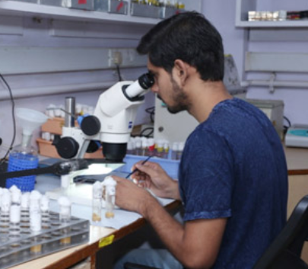
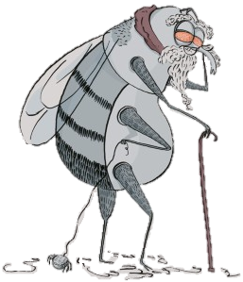
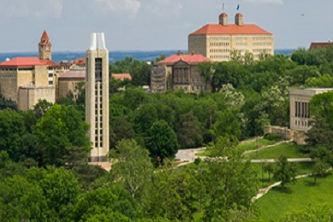
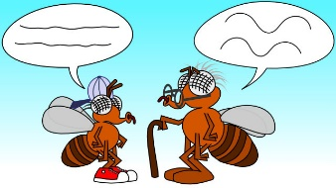


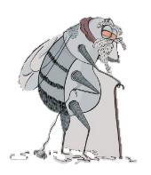
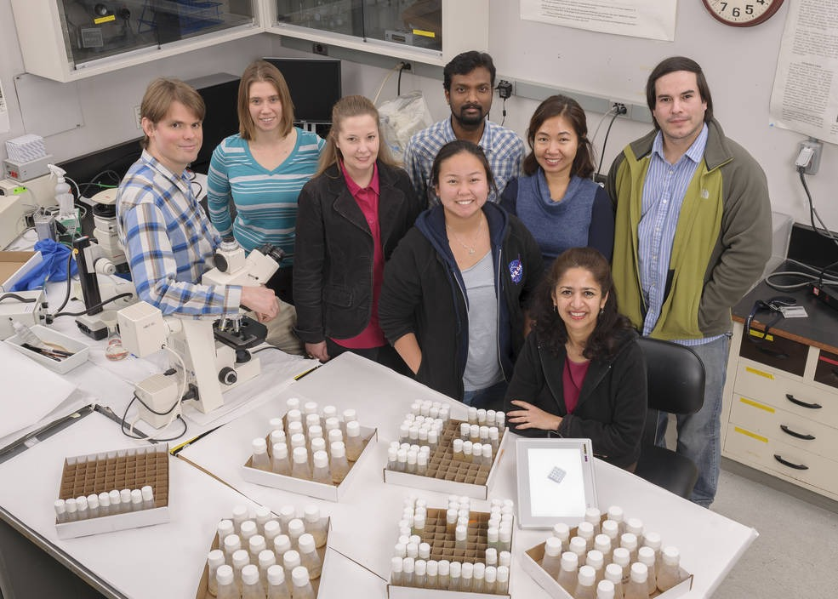



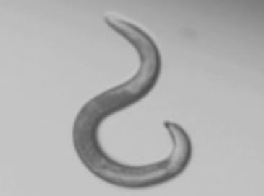

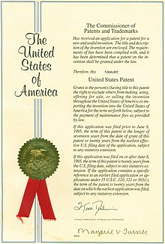


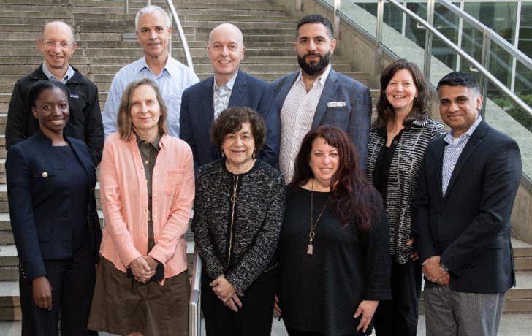

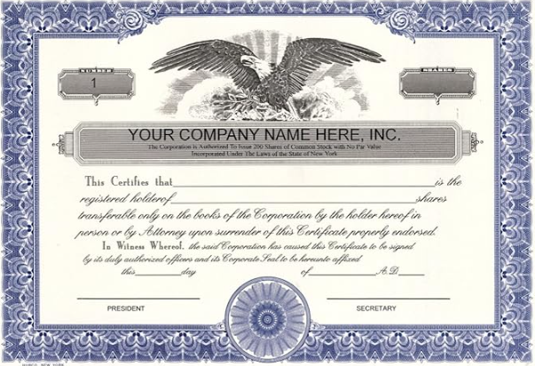

Age-Old Conflicts (& Impacts)
Bobby Bill
Dr Bill, PI
Consultant
Collaborator
Relationship ‘Evolved’
‘Gift’
Sci Adv Bd
Dr Bill
$12,000+
Big Pharma
$180K
Stock
Collaborator?
Image sources available on request
Notes:
https://www.statnews.com/2018/08/20/lab-worm-c-elegans/
https://www.ccmb.res.in/Facilities-Services/Research-Facilities/Drosophila-Facility
https://www.nature.com/articles/nrg.2016.129
https://blog.eoscu.com/blog/why-are-r01-nih-grants-such-a-big-deal
https://ummicrogsa.weebly.com/microblogs/dr-sharmila-bhattacharya
https://www.the-scientist.com/an-aging-related-effect-on-the-circadian-clock-31991
https://www.skyscrapercenter.com/building/fulton-labs-at-1375-west-fulton-market/35832
https://www.pexels.com/search/consulting/
https://www.amazon.com/American-Vinyl-OHare-Airport-Sticker/dp/B06XHW2FTW
https://www.bcm.edu/academic-centers/space-medicine/translational-research-institute/our-team/scientific-advisory-board
https://kpmg.com/ky/en/home/insights_new/2017/01/china-tax-alert-01.html
https://finance.yahoo.com/news/check-tax-hacks-gifting-money-175907616.html?guccounter=1&guce_referrer=aHR0cHM6Ly93d3cuZ29vZ2xlLmNvbS8&guce_referrer_sig=AQAAAAtfyA7Kb2WkCra6Q_n7EbkctKtF6vAEEKh7UitpkBOgHu0LZemVSBWR8ZSDgRhHDCcZEpD85mr9rFOiCgKQdSeBAUAcrSjly8CABpdpMSCUAnHLc-0G8eRwQB2ywHzACEbWhQ0upVZaFIXVmfBF3OpDCBnRbOmtouYcIVnvQypt
https://www.580wibw.com/kansas-university-to-close-oliver-hall/
https://en.wikipedia.org/wiki/Patent
https://observatory.tec.mx/edu-news/types-of-teachers/
https://www.sciencedocs.com/writing-a-scientific-manuscript/

Slide 6
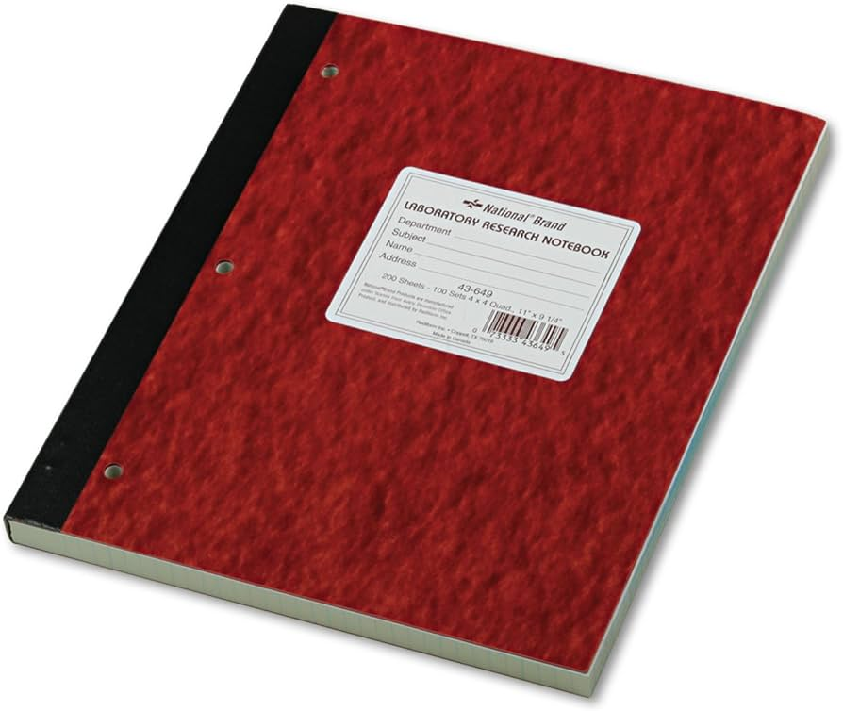

Age-Old Conflicts & Reflection
Communicate
Transparency
Trust
Team
Percent Effort – cover commitments
Know Goals & Endpoints
Know & Follow Policies
Keep complete records
Notes:
Hands: https://www.dailymail.co.uk/news/article-2299142/Green-light-doctors-date-patients-long-use-professional-judgement-decide-appropriate.html

Slide 7
Authorship
Put it before them briefly so they will read it, clearly so
they will appreciate it, picturesquely so they
will remember it and,
above all, accurately
so they will be
guided by its
light. Joseph Pulitzer
Image modified from & attributed to: Image provided by Times Higher Education.

Slide 8
Authorship
Resources:
_____. Defining the Role of Authors and Contributors. International Committee of Medical Journal Editors. 2023.
https://www.icmje.org/recommendations/browse/roles-and-responsibilities/defining-the-role-of-authors-and-contributors.html
Strange K. Authorship: why not just toss a coin? Am J Physiol 295: C567-575, 2008.
Dance A. Authorship: Who's on first? Nature 489: 591-593, 2012.
Albert, T & E Wager. How to handle authorship disputes: a guide for new researchers. The COPE Report, 2003. p 32-34.

Slide 9
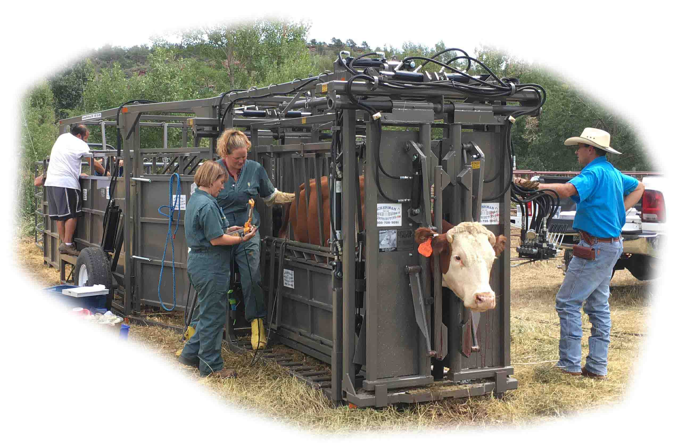
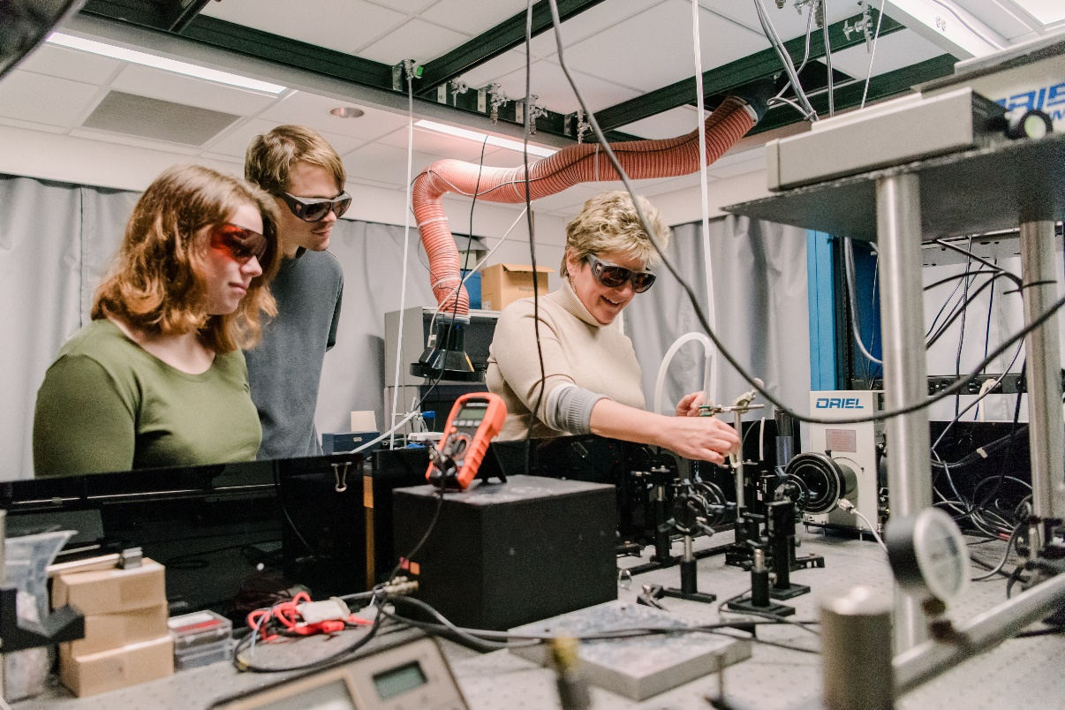


Authorship
Notes:
https://www.nature.com/articles/d41586-018-05159-0
Credit: Hero Images/Getty
https://www.nature.com/articles/d41586-024-00580-0
Credit: Spencer S. Watson
https://ackermansonline.com/dist/titan-hyd-portable-hyd-chute-twin-tub-system.htm
https://kellylab.umbc.edu/wp-content/uploads/sites/418/2021/03/Lisa-Kelly-lab19-1667.jpg

Slide 10
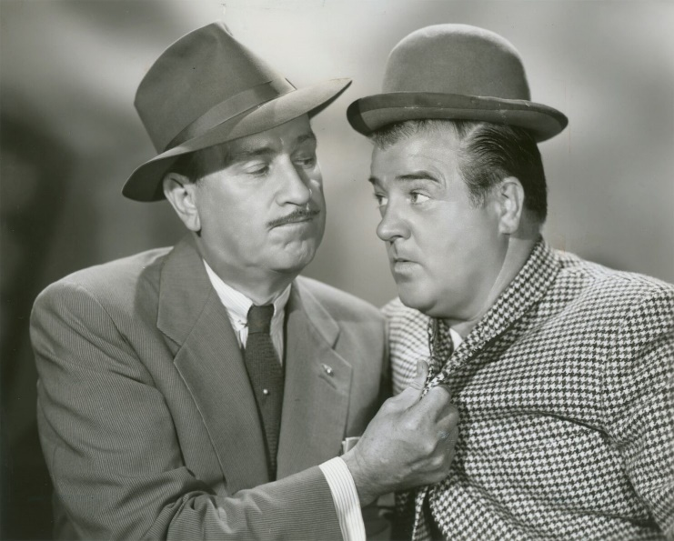
Responsibility & Accountability
Author responsibilities:
Direct & substantial intellectual contribution
Engage in:
  Concept, Conduct, Collect, Condense, Compose, Approve
  Creativity, true intellectual content
Discuss early & often
Author accountability
Reveal conflicts of interest (COI)
All authors accountable for the accuracy and
integrity of all aspects of the work
  Requires communication & trust
https://travsd.files.wordpress.com/2023/03/ca-times.brightspotcdn.jpg
“Who’s on first?”
Because
Why
Nobody
What
IDC
IDK
Tomorrow
Who
Today
Notes:
Ask yourself, what would the paper be like without the intellectual input of this person?
Could the same result have been achieved with the remaining authors directing another person?

Slide 11
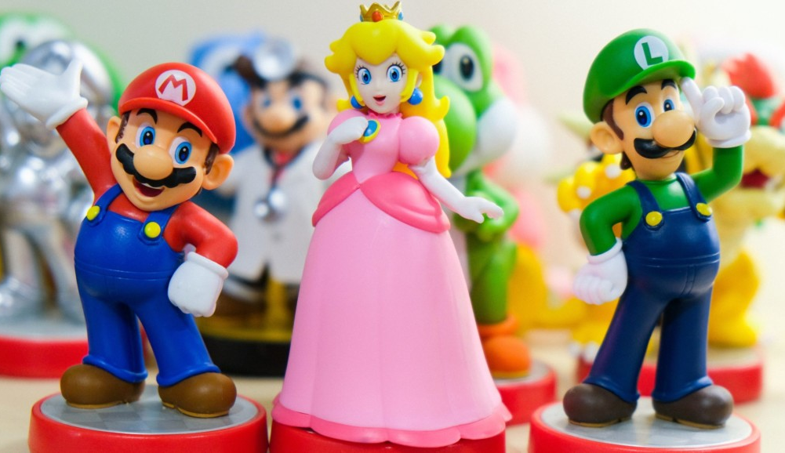
Authorship Conventions
Types of authorship:
First
Last
Middle
Primary
Senior
Corresponding
Guest
Ghost
Honorary
Courtesy
Posthumous
Extortion of
Denial of
Author order:
First, Last
Discipline associated
Flip a coin?
Discuss early
I’m an author,
or else …
https://scopeblog.stanford.edu/2021/12/13/whos-on-first-duking-out-scientific-paper-authorship-order/

