Slide 1
Research & Laboratory
Safety
Recording Information
& Data Integrity

Slide 2
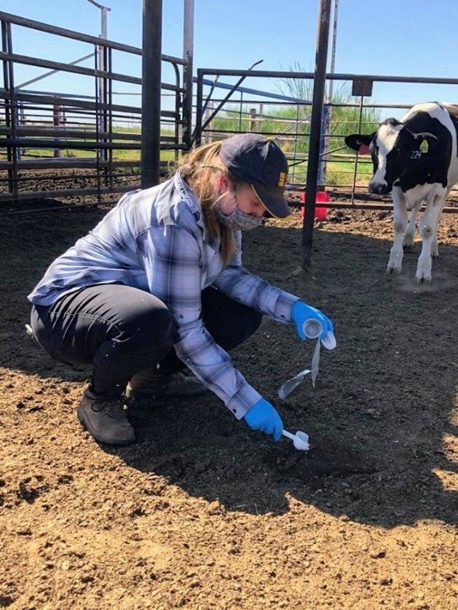
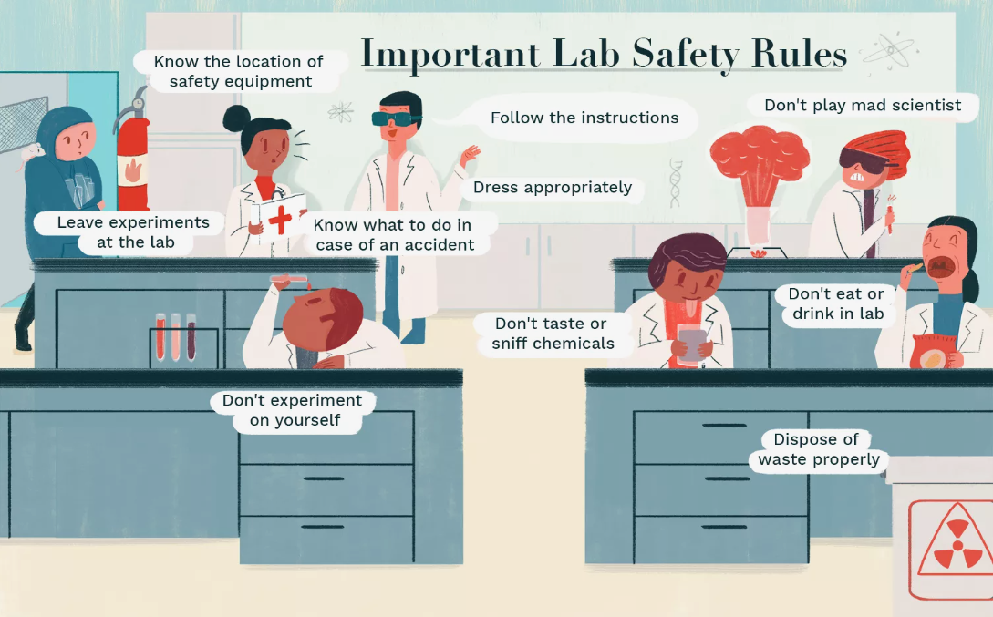
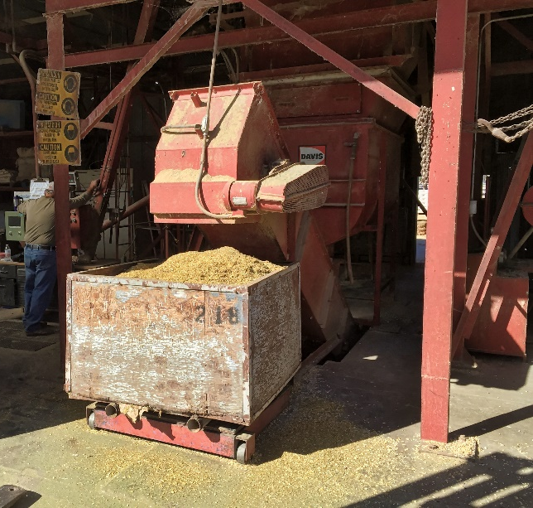
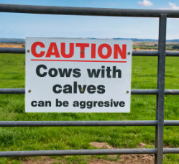
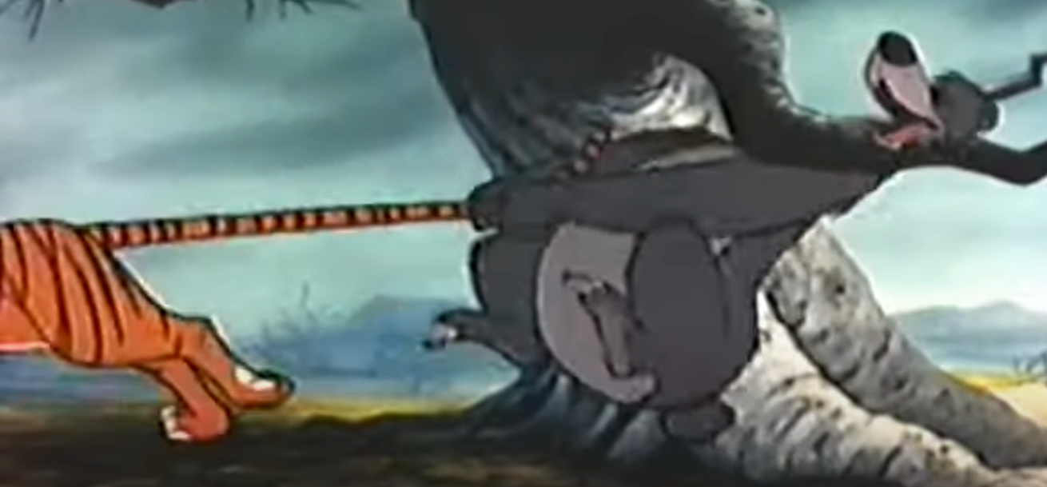
“Are you kiddin’?
There’s teeth in the other end.”

Slide 3

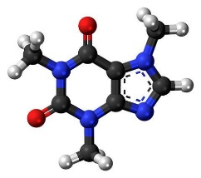
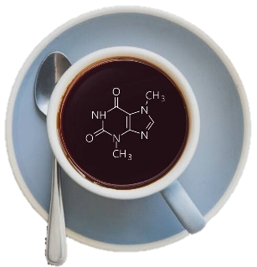

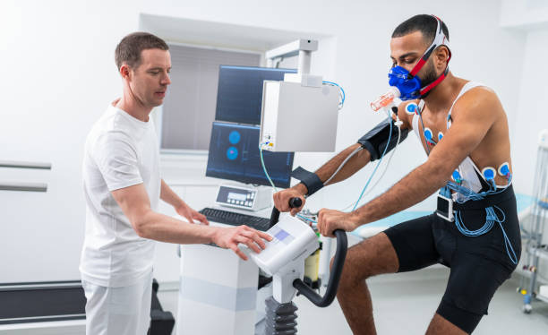
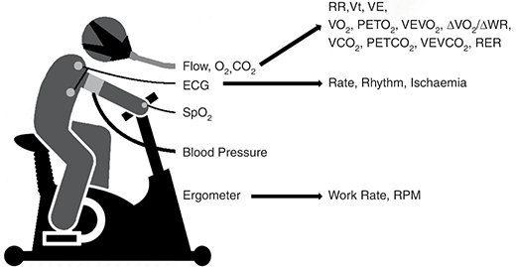
Caffeine Safety
To test the impact of caffeine on sport performance
Two undergraduate student volunteers
https://www.istockphoto.com
https://www.cambridge.org
Notes:
March 23, 2015
1) Undergrad teaching demonstration
https://www.istockphoto.com/photos/cardiopulmonary-exercise-test
https://www.cambridge.org/core/books/abs/cpet-made-simple/what-is-cardiopulmonary-exercise-testing/F8DE6BDEF921148DF4235FE6D77F5DF0

Slide 4

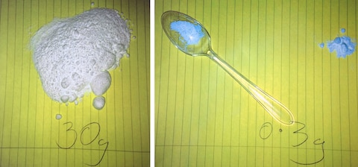

Caffeine Safety
New protocol
  Bulk caffeine versus tablets
Calculation error; 300 mg -> 30 g
  Decimal place error (100x)
  Calculated electronically; not written or checked
Medical emergency
  Dialysis, loss of 22-26 lbs, students recovered
Court: Lack of supervision – inexperienced / incompetent
University fined £400,000 ($500,000) + expenses
Notes:
March 23, 2015
Who was in charge? - In lay press I did not find evidence of a laboratory supervisor or reference to a responsible TA.
News reported that calculations were made and that caffeine was weighed, but does not indicate who took these actions.
The news publications did not suggest that anyone in the room at the time was taking responsibility.
Was there institutional oversight? - There is no reference to an IRB.
1) Undergrad teaching demonstration
2) New protocol – weigh caffeine versus use a tablet; persons weighing did not have experience
Decimal point error!
3) No indication of supervision
4) No indication of a written protocol to follow; not an updated protocol?
5) No written notes were mentioned

Slide 5
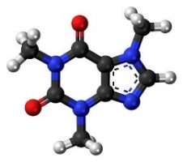
Caffeine Safety & Risk Assessment
If you were the student volunteer, how would you ensure that this would not happen to you?
If you were the TA/lab coordinator (or classmate, professor/instructor, department head), how would you ensure that this type of error does not happen in the teaching program?

Slide 6

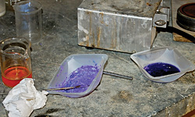
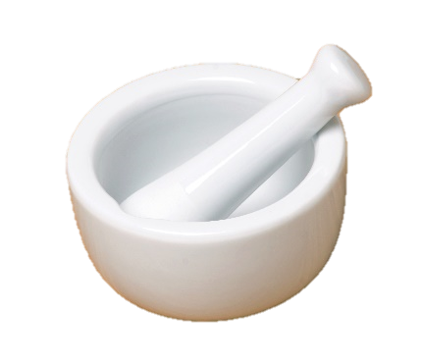
‘The Accident’
Preston Brown, fifth year graduate student, training newer student
Working with ~5 g nickel hydrazine perchlorate (explosive) under hexane
Used mortar & pestle to gently remove clumps
Removed PPE & was working at bench
One last stir – mortar exploded
Brown lost three digits on left hand, lacerated right hand & perforated left eye
Notes:
January 7, 2010; Preston Brown, graduate student
Advisor Louisa Hope-Weeks

Slide 7
Leading to ‘The Accident’
Labmates were disturbed by [Brown’s] conduct in the lab prior to the incident. His space was disorganized, items were not labeled, and “there had been conflicts over work space, cleanliness of the lab and use of chemicals”
Brown started scaling up syntheses [eight months before accident], first to 1 to 3 g and then to 5 g
Colleague told Brown the scale-up was inappropriate; Brown reportedly responded that things were “just fine.”
Colleague apparently failed to report the scale-up to either Weeks (PI) or Hope-Weeks (Co-PI)
Notes:
January 7, 2010; Preston Brown, graduate student
Advisor Louisa Hope-Weeks

Slide 8
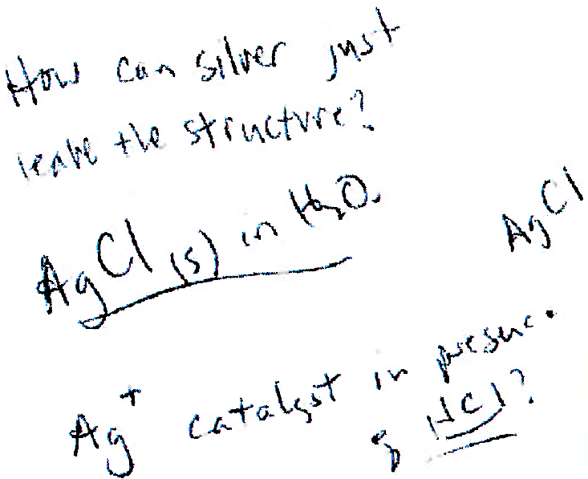
Leading to ‘The Accident’
Brown transported as much as “several grams of compounds” at a time in glass vials in a backpack or coat pocket
Weeks (PI) told police that a student reported to him that Brown “would often avoid necessary steps to characterize compounds in order to save time”
Several vials of material were at Brown’s home, unlabeled
  Destroyed by authorities
Many laboratory vials were unlabeled
Laboratory notebook provides no detail
Lab
notebook
entry
Notes:
January 7, 2010; Preston Brown, graduate student
Advisor Louisa Hope-Weeks

Slide 9


Contributing to The Accident
Studying energetic or explosive compounds
  ‘Improvised’ explosives
  Nickel hydrazine perchlorate
‘Make no more than 100 mg’ – synthesized 10 g
  Policy not formalized or enforced in laboratory
No records of syntheses and dispositions
Wear PPE, practice safety – inconsistent
Insufficient safety accountability by PI, Department & University
No formal training for students
Brandon
Weeks
Louisa
Hope-Weeks
Notes:
January 7, 2010; Preston Brown, graduate student
Advisor Louisa Hope-Weeks
What is a policy versus a guideline? (If it is not enforced, it is not a guideline!)

Slide 10
Avoiding an Accident
What is the role of each of these persons in promoting and ensuring safety in the laboratory?
  New researcher (i.e., you)
  Colleagues (other students, including grad students)
  Laboratory manager
  Primary investigator
  Department head
  Dean (Associate Dean for Research)
  Vice President for Research
  Others

Slide 11
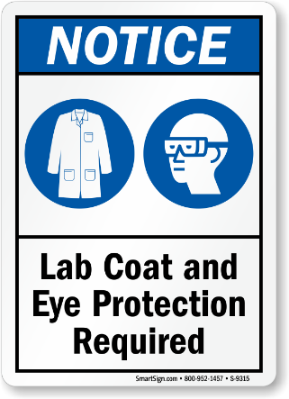
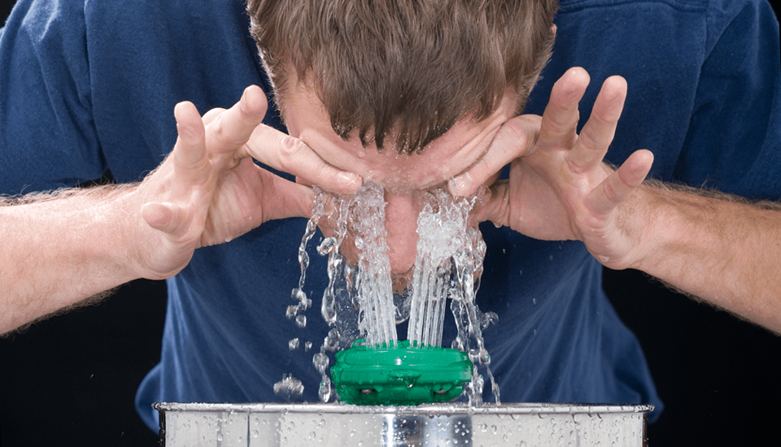


Laboratory Safety - Reflection
Communicate with mentor and co-workers
Complete all safety training
Know your environment - Risks, engineering controls
Wear appropriate PPE & use safety devices
Follow laboratory policies & SOPs
  Know and practice protocols
Expect colleagues to be safe
Record aims, goals, preparations, calculations, activities outcomes and conclusions
Laboratory notebooks are legal documents

Slide 12

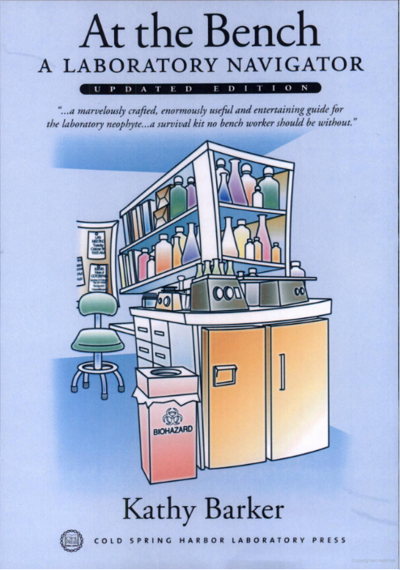
Records, Data Storage & Security
Chapter 5:
Laboratory Notebooks
Excellent guides to survive flourish in the laboratory environment
Chapter 8: Data Management and Laboratory Notebooks

Slide 13
Why Keep a Laboratory Notebook
Provide a complete record of why experiments were initiated and how they were performed, outcomes, insights & conclusions (self)
Encourage sound thinking. A forum to talk to yourself, to ask questions, to record important thoughts about experimental design & interpretation
Provide information to persons interested in continuing your research. Others may want to repeat and extend your experimentation if you die an early death
  Complete record of rationale, procedures, reagents, data, and thoughts to bequeath (others)
  Notebooks that are kept solely for personal consumption are often illegible and incoherent (usually both) and are worthless to the broader scientific community
To get rich! $$ You may discover or develop something important and in such an event you must have a notebook that supports your claims. If you have not kept up a proper laboratory notebook, other researchers and their patent lawyers will beat you to the Patent Office and to the bank.
modified from https://colinpurrington.com/tips/lab-notebooks/ & Dr Kurt Kwast (University of Illinois)

Slide 14
Why Keep a Laboratory Notebook
Scientific
Reproducibility
Publications
Grant proposals
Legal
Grants & Contracts
Quality Assurance
Product Approval
Patents
  Supporting data
  Dates
  Proof of practice
modified from Dr Kurt Kwast (University of Illinois)

Slide 15
Essential Elements
Useful Books Explain
What you did
Why you did it
How you did it
When you did it
Where materials are
Outcomes with locations
Your interpretations
Contributions
Good Books are
Legible
Organized
Accessible
Allow repetition of experiments
Compliant with granting agencies AND institutional requirements
Accurate
Complete
Secure
modified from Dr Kurt Kwast (University of Illinois)

Slide 16
Information to Record
Date (& experiment name or number)
Purpose, hypothesis & goal
How you did it? (approach & methods)
  Sources of materials (vendor, lot #’s, etc.) & preparation
  All calculations with units for all components (e.g., mass, volume, concentration)
  Self-references to lab-made or proprietary reagents (notebook & page)
  Organisms: type, line, passage, generation, age, last fed, etc.
  Conditions: temperature, atmosphere, pH, osmolality, etc.
  Can refer to centralized methods notebook with version number
    Must include verification of timing, protocol steps, QA parameters, etc.
  Collaborators – who helped? Reference to their notes
modified from https://colinpurrington.com/tips/lab-notebooks/ & Dr Kurt Kwast (University of Illinois)

Slide 17
Information to Record
Results (Data/observation/location of generated materials)
  Tangible (photographs, radiographs, printouts, etc. pasted in or location)
  Intangible (qualitative assessment, descriptions, calculations)
  Electronic file names and storage location(s); Derivative files
May allow space for comment when data are reviewed or distilled
Discussion
  Can be about any of the above topics (i.e., not just as conclusions)
Conclusions/objective interpretation
  Include any artifacts or errors made or observed
  Reflect back to hypothesis and goal
What’s next (a.k.a. future directions)?
  Next experiments / Optimizations / Modifications
modified from https://colinpurrington.com/tips/lab-notebooks/ & Dr Kurt Kwast (University of Illinois)

Slide 18
Naming Electronic Files
File must be accessible & stable
  Software available to access, manipulate & analyze data
  Naming must be interpretable by others who will access the information
  Data archive file unchanged by accessing, copying or compressing
Name must be unique, meaningful and logical (searchable)
Pr000FTpKeywordxxx00a.xxx
YYMMDDExTECKeywordxxx.xxx
26051901bdsF508bicarb.csv
Project: 5 alpha-numeric
Extension
File Content: 3 text
Version: 2 numerals, 1 text
10 α numeric
Date: note format, 6 numerals
Extension
Run # on this date: 2 numerals
10 α numeric
Person performing experiment: 3 initials
Example:
Notes:
csv = comma separated values

Slide 19
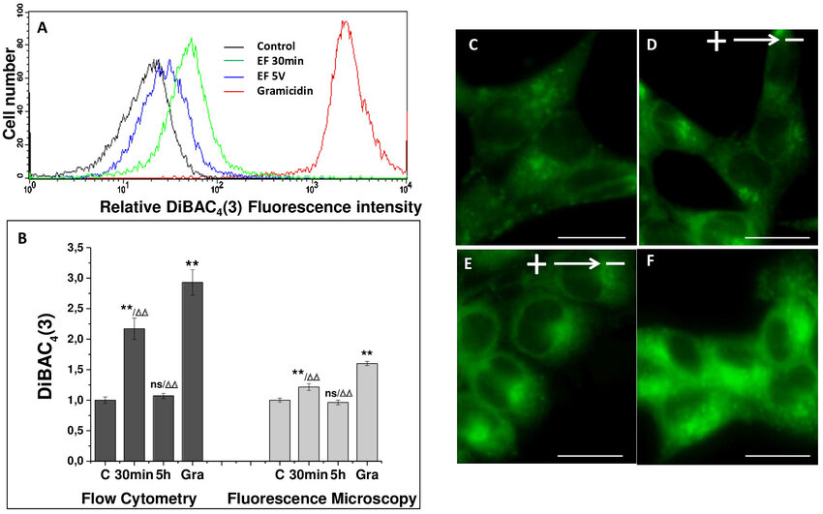


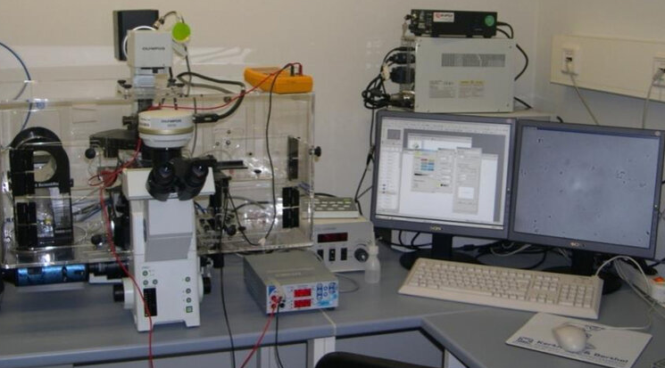

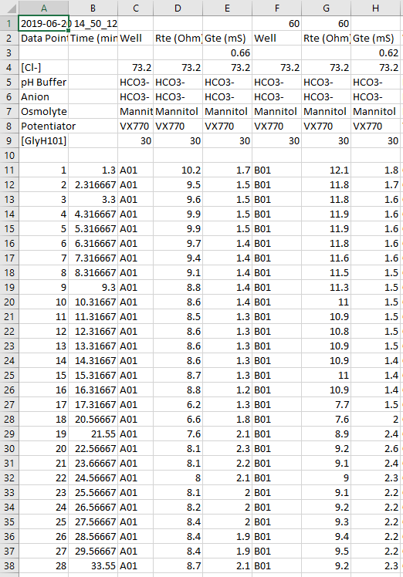
Naming & Storing Electronic Files
16 TB RAID
Lab Archives
Archive data
Organize
Date
User
Project
Agency
Organism
Access
New
Read
Write
Modify
Re-name
FACS
Images
Three Trts; Two Time Pts; x.std or x.prp
Named?
Stored?
Access?
Data Acquisition Systems
Analysis, Distillation,
Aggregation, Presentation,
Summary , Discussion
Intermediate & Final Derivative Files
(.prp), .csv, .dat, .txt, .pdf
.jpg, .tif, .psd, .jnb, .doc, .docx .xls
Images: Guerra-Huhne et al. Front Biosci 27: 273, 2022.
Notes:
std = standard; prp = proprietary
JPG/JPEG = Joint Photographic Experts Group; lossy compression
TIF/TIFF = Tagged Image File Format; raster image, lossless file
PSD = PhotoShop Document (Adobe)
JNB = SigmaPlot (Jandel Corp)
acquisition system & data images:
Guerra-Huhne J, Bola S, Calzia D, Alexopoulou D, Funk RHW, Muhlen SS, and Roehlecke C. Effect of Direct Current Electric Fields on Cone Like Retinal Photoreceptor Cells. Front Biosci (Landmark Ed) 27: 273, 2022.

Slide 20

Ownership & Access
Grants:
  Typically, the grantee ‘institution’ (e.g., university) owns all data, including laboratory notebooks
  Primary investigator/Program director responsible for recording, organizing and securing data
  Granting organization may require [open] access to data files and/or submission of information to repositories
  Granting organization may require access to data, including notebooks, at will (e.g., audit)
Contracts
  Typically, contracting agency (e.g., corporation) owns all data, including laboratory notebooks
    May affect opportunity to use data for future projects or for publication
  Primary investigator/Program director responsible for recording, organizing, securing and delivering data

Slide 21

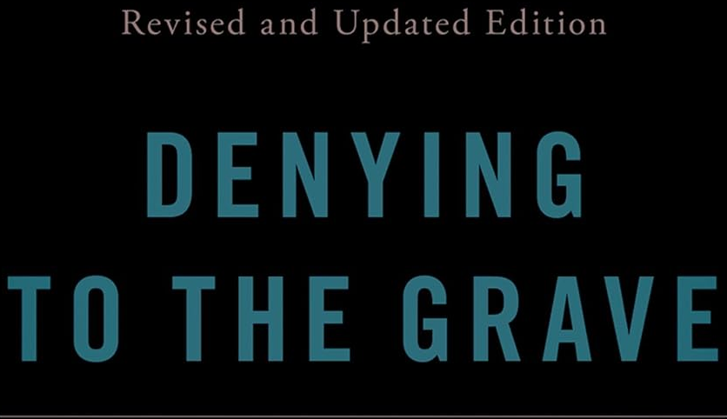

Record-keeping - Reflection
$$
Laboratory notebooks are really important!
What, Why, How, When, Where, Outcomes, Interpretations, Contributions
Legible, Organized, Accessible, Accurate, Complete, Secure
Include all calculations!
Cataloging within a system is really important!
  Develop effective expandable system to name and organize items
  Access to reagents and products
  Access to archival, intermediate and derivative files

