Slide 1
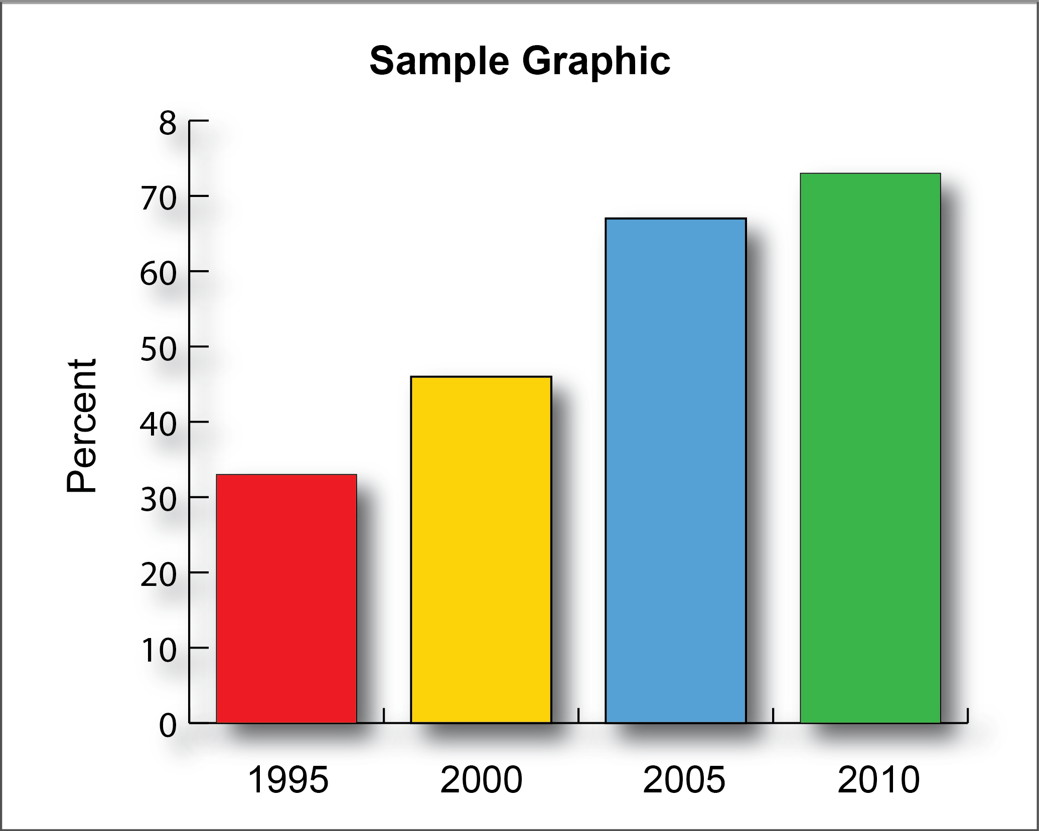
Poster Title Here
Authors
Affiliations
Introduction
Results
Summary/Conclusion
Place body text here.
Place body text here.
Place body text here. Please use Bold text.
Materials & Methods
Place body text here.
Area may also be used for additional text or graphics.
Use high resolution graphics and photos. At print size, images should be 300 dpi or greater)
Please use Arial 24 font for figure/table captions. .
References
Place body text here. Please use Arial 24 font.
Acknowledgments
Place body text here. Please use Arial 24 font.

